Slide 1
Gutz Evaluation of Lifecare Advantage
Dave Gutz 2025 - 04-08

Slide 2
The Main Assumptions
LC | Single | Double
Entrance | $ 855,000 | $ 900,000
Monthly | $ 8,100 | $ 9,600
AL Entr | $ 199,500 | ? again ?
Lifecare | Independent | Assisted
Both in Unit 304 | $ 9,600 | $ 0
1 in #304 1 in AL | $ 8,100 | $ 9,200 ? prepaid
Both in 1 BR AL | $ 0 | $ 13,500 ?
1 in 1 BR AL | $0 | $ 10,000 ?
AL prepaid for LC?
AL entrance fee for 2nd resident?
Continuing Care | Independent | Assisted
Both in Unit 304 | $ 3,750 | $ 0
1 in #304 1 in AL | $ 3,550 | $ 9,200
Both in 1 BR AL | $ 0 | $ 13,500
1 in 1 BR AL | $0 | $ 10,000
CC | Single | Double
Entrance | $ 442,000 | $ 481,000
Monthly | $ 3,550 | $ 3,750
AL Entr | $ 199,500 | ? again ?

Slide 3
Summary – We can have Lifecare
Starting with $6.3M gives us ‘room to maneuver’ We’ll have portfolio growth despite Lifecare
The more assisted living time, the more the benefit of Lifecare. And at short assisted living time Lifecare is a loss.
Break-even years depend on time spent in Independent living
Decision is easier given initial worth. Differences between CC and LC are smaller than uncertainty of markets – as you’ll see
Years Independe | Break-even Pt | Mean Worth at End | Range
5 | 4 yrs | Approx $ 6.3M
10 | 5 yrs | Approx $ 6M
15 | 6 yrs | Approx $ 6M

Slide 4
Variation Story
Lifecare as an investment will usually have positive ROI
  So does Continuing Care - not much different there. Both will likely gain 3x
  We will likely lose $1M compared to CC
  But that isn’t much difference compared to market uncertainty 300%

Slide 5
Intangibles
Lifecare offers shelter from markets during assisted living
Lifecare offers shelter from the David Gutz Trust during assisted living (maybe Suzanne’s changes aren’t needed anymore)

Slide 6
David and Katherine’s Monetary Split
Kathy’s share based on 30% housing and her normal share for entering CC
Kathy savings $ 861,000
David savings $ 4,808,000
  CC 2:1 → $ 481,000 = $ 320,700 + $ 160,300
  LC → $ 900,000 = $ 739,700 + $ 160,300
Kathy take-home $ 4,219 → < $ 1,265 housing
David take-home $ 9,105. His share $ 8,335
  $ 9,600 = $ 8,335 + $ 1,265
We both need to check if monthly LPL hits are needed
CC | Single | Double
Entrance | 442,000 | 481,000
Monthly | 3,550 | 3,750
1/3 of CC Entrance
30% of take-home
LC | Single | Double
Entrance | 855,000 | 900,000
Monthly | 8,100 | 9,600

Slide 7
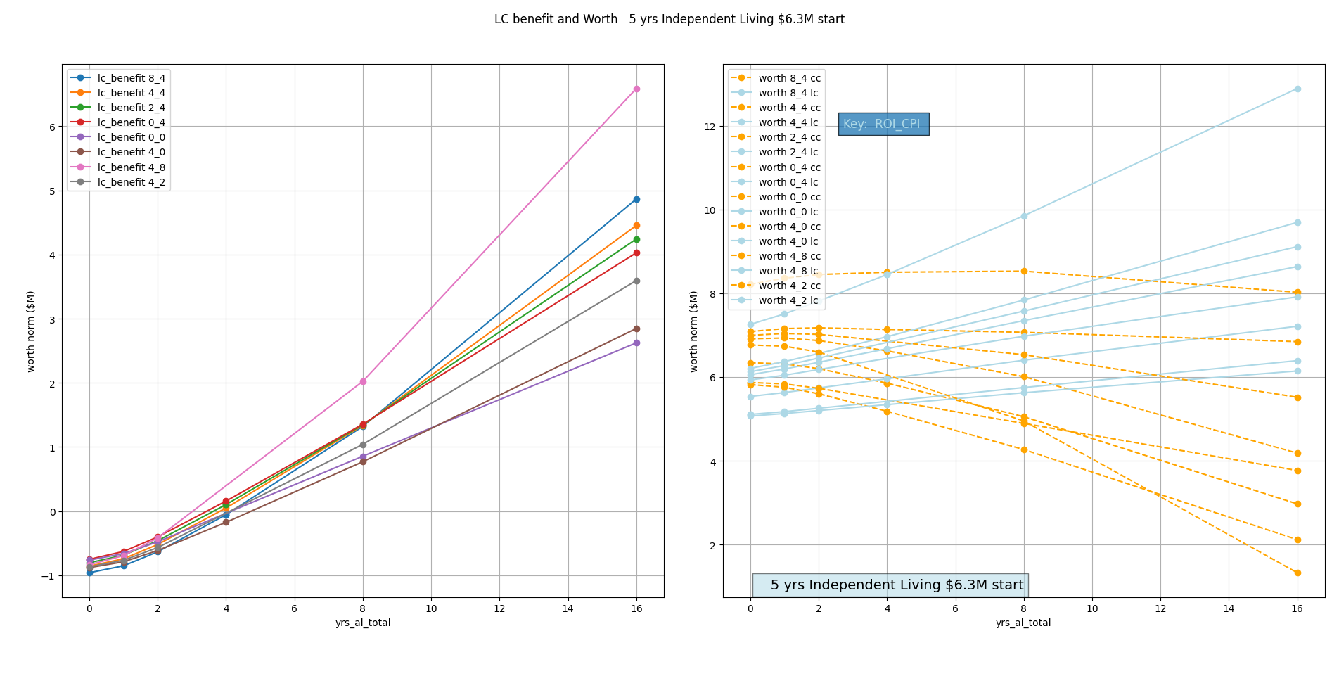
5 yrs Independent
All $ normalized to $2026

Slide 8
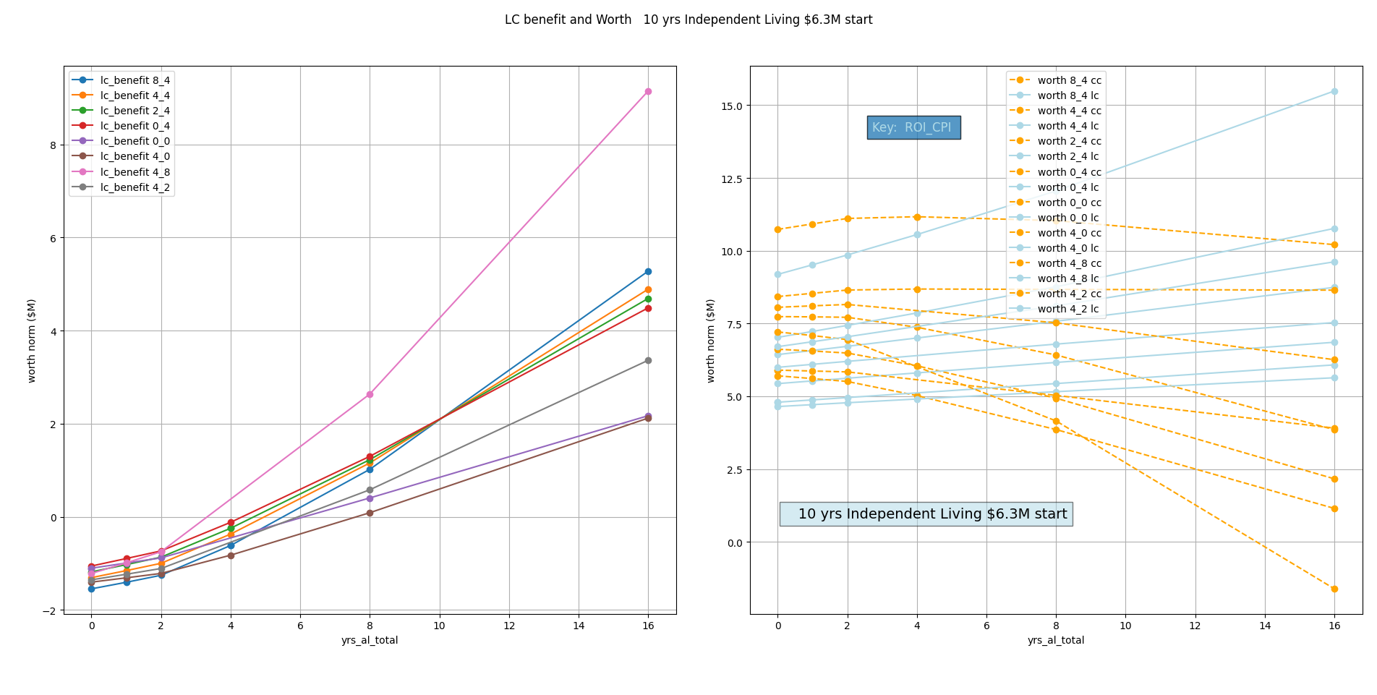
10 yrs Independent
All $ normalized to $2026

Slide 9
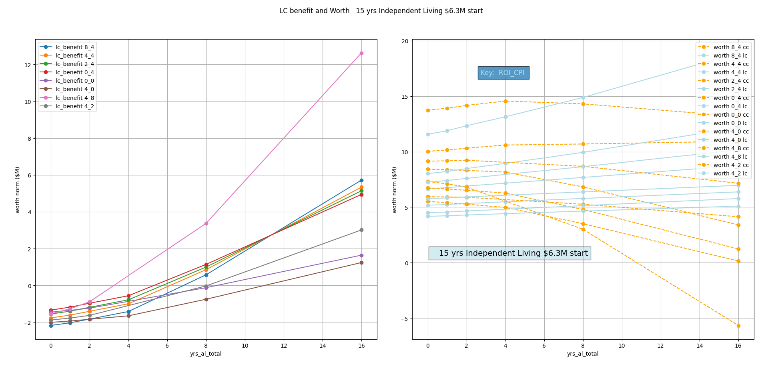
15 yrs Independent
All $ normalized to $2026

Slide 10
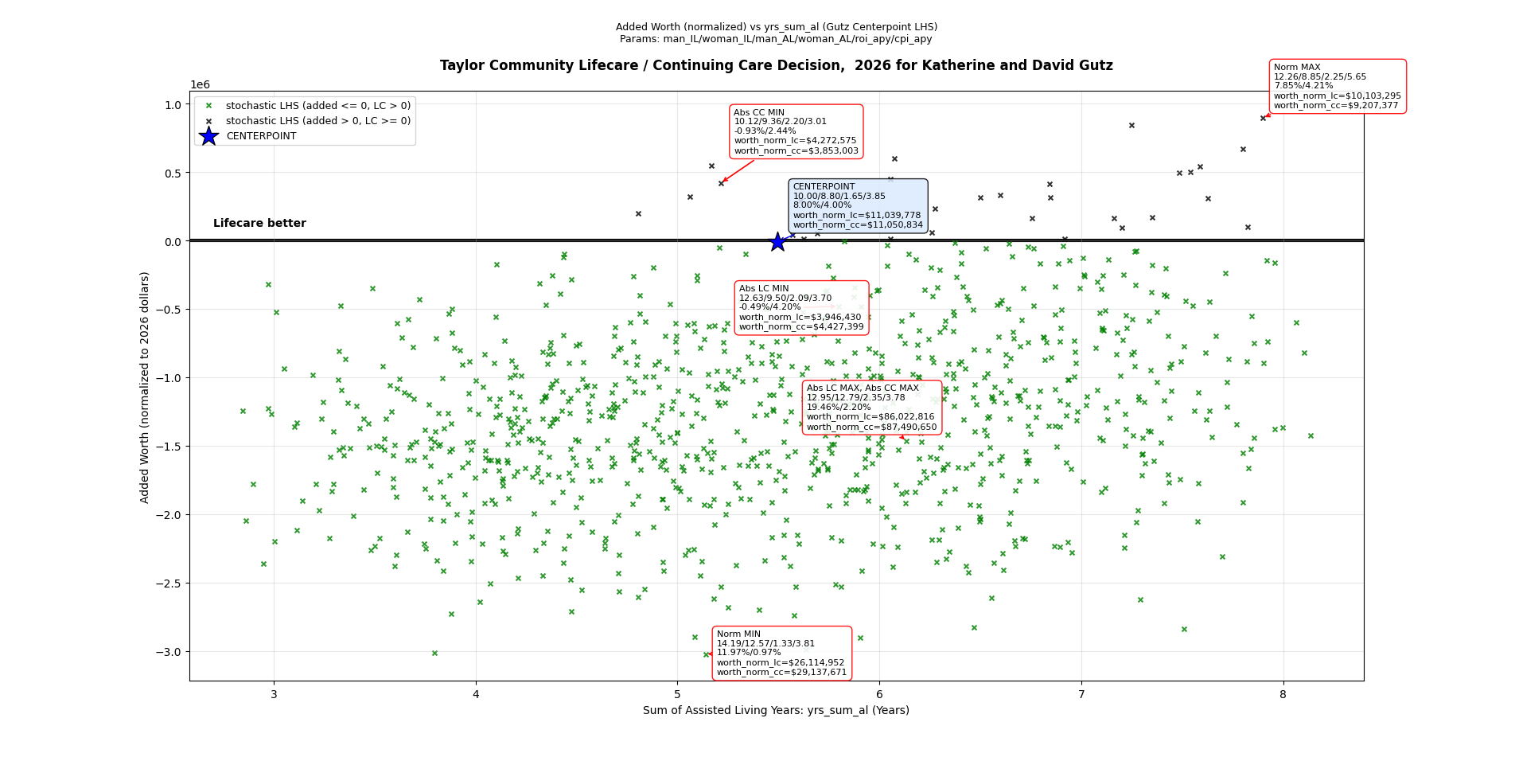
Relative Returns
All $ normalized to $2026

Slide 11
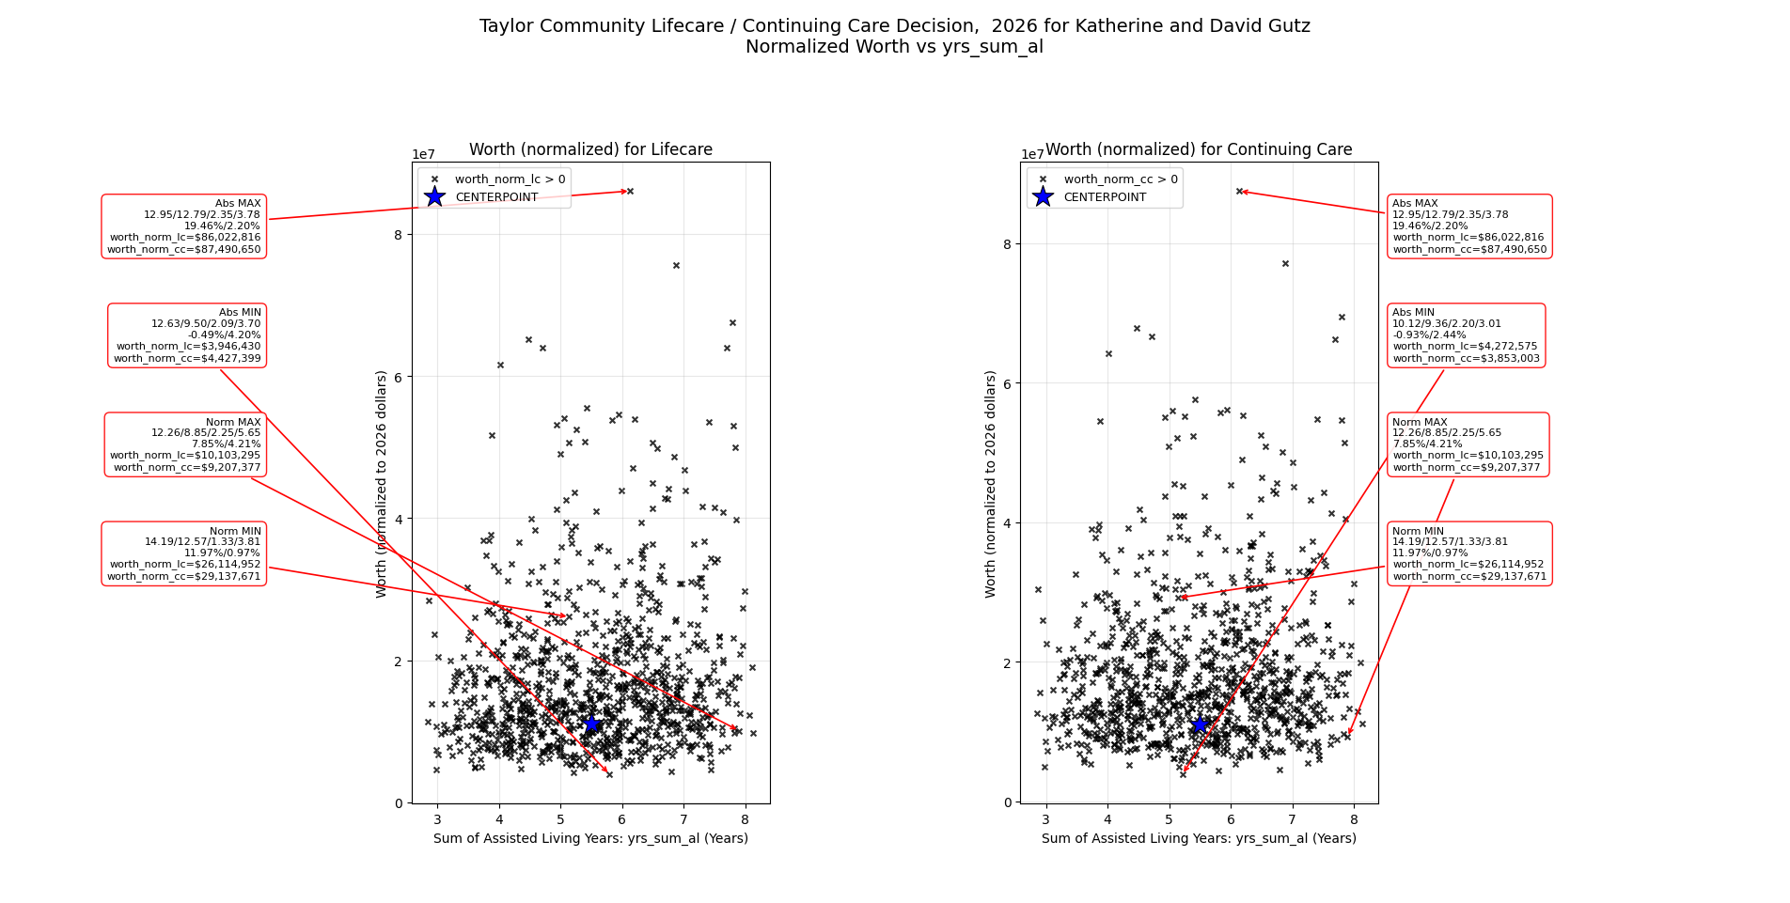
Absolute Returns
All $ normalized to $2026

Slide 12
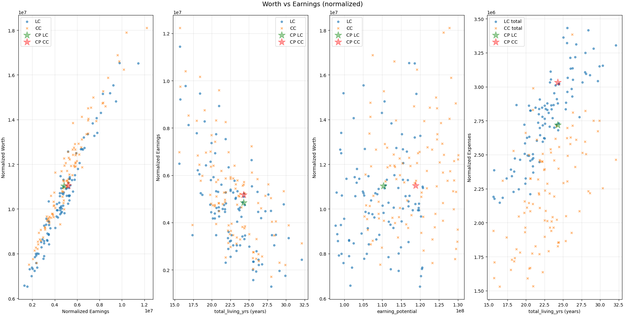
Trends – LC and CC close, within wild markets
H
U
G
E
M
A
R
K
E
T
V
A
R
I
A
T
I
O
N
LC ~ CC
All $ normalized to $2026

Slide 13
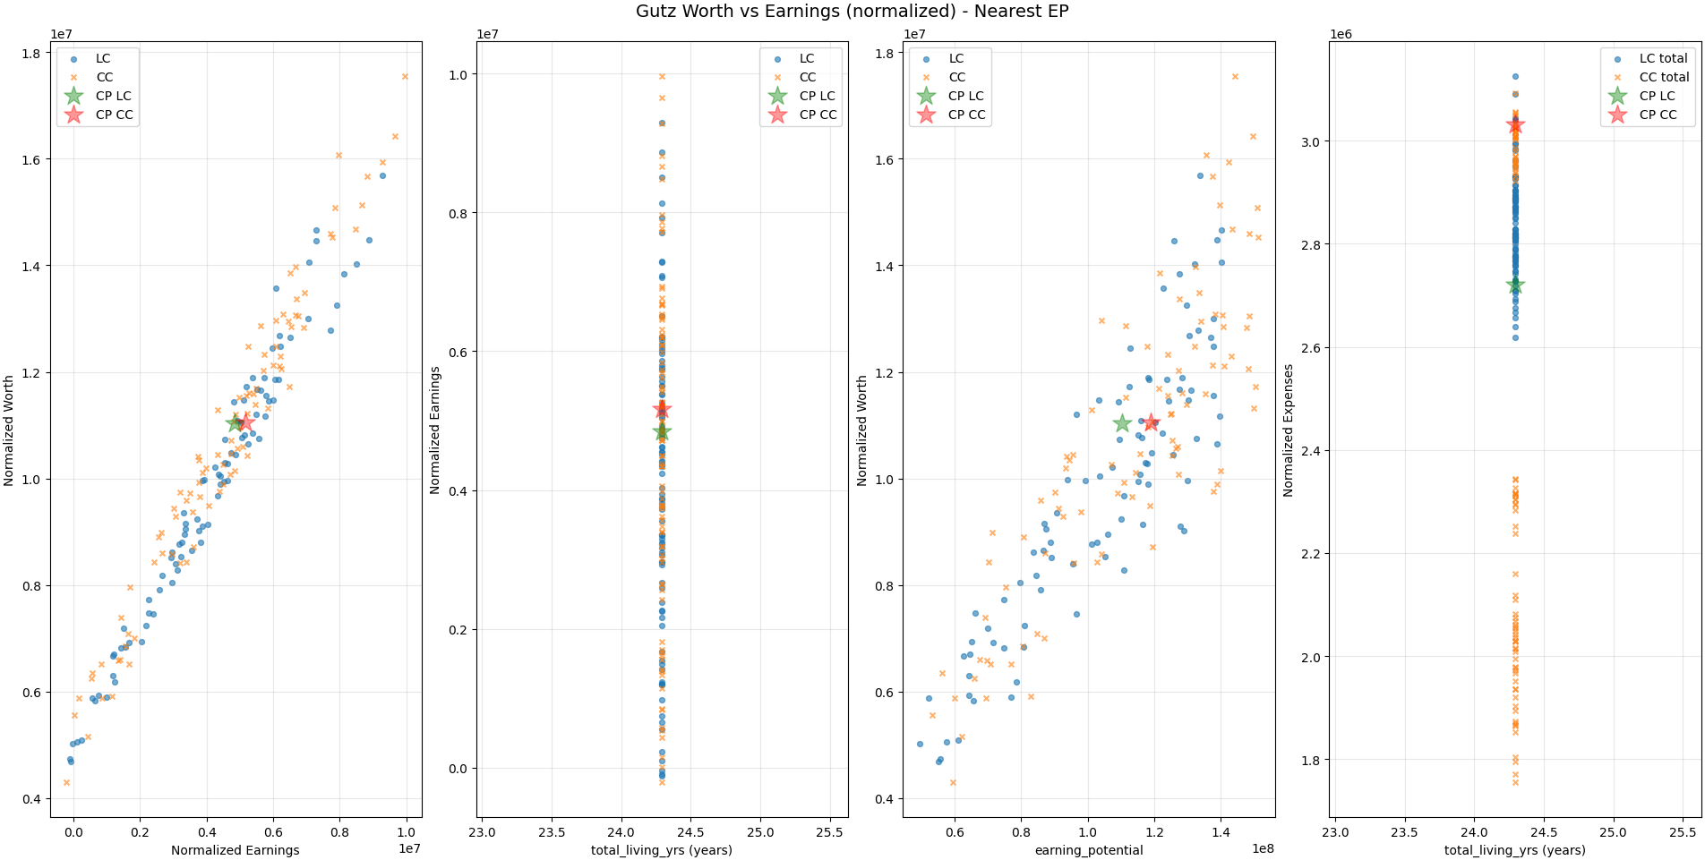
Repeat Trends for Fixed IL, AL yrs
Almost all variation in worth is explained by the market roi/cpi

